Slide 1

Introduction to Interfaces
The Key to Maintainable & Extensible Code in OOP

Slide 2

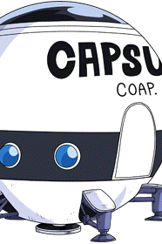
Encapsulation
“The bundling of data with the methods that operate on that data, or the restricting of direct access to some of an object’s components”

Slide 3
Encapsulation
Encapsulation in C++ is accomplished primarily through private and protected members and methods
Protected members are not accessible outside the object’s scope except by subclasses
Private members are not accessible outside the object’s scope even to subclasses
Note: a member or internal member variable is a piece of data associated with an object while a method or member function is a function associated with the object

Slide 4
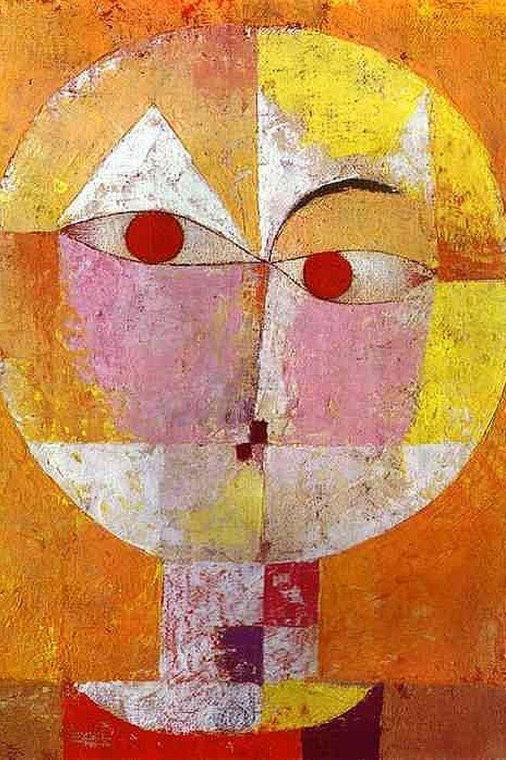
Abstraction
“Handle complexity by hiding unnecessary details from the user [allowing them to] implement more complex logic on top of the provided abstraction without understanding or even thinking about all the hidden complexity”

Slide 5

Abstraction
Abstraction is primarily accomplished through public methods
Accessors (getters) and mutators (setters) allow for controlled access and modification to encapsulated members, or their absence specifically disallows these operations
Other methods allow for the object to be used in specific and complex ways without the need for the user to understand what is happening internally in the function or object

Slide 6
Interface
Abstraction and encapsulation come together to create (and enforce) an interface
“An interface is a description of the actions that an object can do” [3]
Abstraction allows us to define what we will allow users to do with an object and encapsulation stops them from doing anything else with that object
All the publicly accessible methods associated with an object represent that object’s interface
Interfaces are not specific to object oriented programming and are common across many programming paradigms
Notes:
[3] https://www.cs.utah.edu/~germain/PPS/Topics/interfaces.html

Slide 7
C++ Interface
class Cat {
private:
string name;
int age;
public:
void set_name(string n) { name = n;
}
string get_name(){
return name;
}
void sound() {
cout << “meow”;
}
};
class Dog {
private:
string name;
int age;
public:
void set_name(string n) {
name = n;
}
string get_name() {
return name;
}
void sound() {
cout << “woof”;
}
};

Slide 8
Python Interface
class Cat:
_name = “”
def __init__(self):
pass
@property
def name(self):
return self._name
@name.setter
def name(self, name):
self._name = name
def sound(self):
print(“meow”)
class Dog:
_name = “”
def __init__(self):
pass
@property
def name(self):
return self._name
@name.setter
def name(self, name):
self._name = name
def sound(self):
print(“woof”)
Notes:
Python has weak encapsulation and all members are always public

Slide 9
Go Interface
type Cat interface {
set_name(n string)
get_name() string
sound()
}
type Dog interface {
set_name(n string)
get_name() string
sound()
}
Notes:
Unlike with C++ and Python, Go (golang) allows you to define an interface directly, so the above code doesn’t actually define any class or objects (more on this in a min)

Slide 10
Review: Inheritance
“[A] mechanism in which one class acquires the property of another class” [4]
A common (though not universal) idea in OOP allowing one class to acquire (inherit) all or a subset of members and methods from another class
Subclasses can typically override methods they inherit from a superclass and can add additional members and methods not present in the superclass
In C++ inheritance, a subclass which inherits from a superclass can be referenced using the superclass’ pointer
This makes it easy to treat a group of similar classes as “the same” by using the superclass pointer to refer to all the various types of subclasses
Notes:
[4] https://www.guru99.com/java-class-inheritance.html

Slide 11
Terminology Note: Superclasses and Subclasses
Superclass and subclass allow us to discuss how a set of classes are related through inheritance
A superclass or parent class or base class is a class that another class inherits from even if it is not itself the most base class
A subclass or child class or derived class is a class which inherits from another class
class A { ... };
class B : public A { ... };
class C : public B { ... };
A is a superclass of B and C
B is a superclass of C
B is a subclass of A
C is a subclass of A and B

Slide 12
C++ Interface & Inheritance
class Animal {
private:
string name;
int age;
public:
void set_name(string n) {
name = n;
}
string get_name() {
return name;
}
virtual void sound() = 0;
};
class Cat: public Animal {
public:
virtual void sound() {
cout << ”meow”;
}
};
class Dog: public Animal {
public:
virtual void sound() {
cout << ”woof”;
}
};
Notes:
Note: the virtual keywords on the right hand side are actually optional. The subclass methods will automatically get the “virtualness” of the function from the superclass

Slide 13
C++ Interface & Inheritance
vector<Animal*> animals;
animals.push_back(new Cat());
animals.push_back(new Dog());
for(auto animal: animals) {
animal->sound();
// prints out “meow” followed by “woof”
}
Notes:
Allows us to treat all Animal subclasses abstractly allowing the user to only think about what they can do with Animals and not each subtype of animal

Slide 14
C++ Interface & Inheritance
class Turtle: public Animal {
private:
float diameter;
public:
virtual void sound() {
cout << ”???”;
}
void set_di(float d) {
diameter = d;
}
};
class Parrot: public Animal {
private:
string color;
public:
virtual void sound() {
cout << ”squak”;
cout << ”I’m a ” << color << ” bird”;
}
};
Notes:
Note: the virtual keywords on the right hand side are actually optional. The subclass methods will automatically get the “virtualness” of the function from the superclass

Slide 15
C++ Interface & Inheritance
vector<Animal*> animals;
animals.push_back(new Cat());
animals.push_back(new Dog());
animals.push_back(new Turtle());
animals.push_back(new Bird());
for(auto animal: animals) {
animal->sound();
}
We’ve added two new types of animals each with its own specific methods and members
Notes:
No changes to the code using the Animal class was necessary since we didn’t modify the interface for the base class

Slide 16
Python Interface & Inheritance
class Animal:
_name = “”
def __init__(self):
pass
@property
def name(self):
return self._name
@name.setter
def name(self, name):
self._name = name
class Cat(Animal):
def __init__(self):
super().__init__()
def sound(self):
print(“meow”)
class Dog(Animal):
def __init__(self):
super().__init__()
def sound(self):
print(“woof”)

Slide 17
Python Interface & Inheritance
animals = [ ]
animals.append(Cat())
animals.append(Dog())
for animal in animals:
animal.sound()
Python does not require types allowing you to mix and match the types of objects you have within a collection (like the animals list)
This means there is no enforcement of the interface, you can have a non-Animal subclass in the list and the program will raise an exception when it tries to run sound() on it
Python does have “type annotations” to partially address this

Slide 18
Python Interface & Inheritance
class Turtle:
def sound():
print(“???”)
animals = [ ]
animals.append(Cat())
animals.append(Dog())
animals.append(Turtle())
for animal in animals:
animal.sound()
Python uses a system called “duck typing” when executing
As long as the object has the method you are trying to run, it will execute it
This means we can create a new class that doesn’t inherit from the Animal class and as long as it has the proper methods it will be executed

Slide 19
Go Interface & Inheritance?
type Animal interface {
set_name(n string)
get_name() string
sound()
}
type Cat struct {
name string
age int64
}
func (c Cat) sound() {
fmt.Printf(“meow”) }
func (c Cat) set_name(n string) {
c.name = n }
func (c Cat) get_name() string {
return c.name }
Go doesn’t have classical inheritance and instead uses only encapsulation

Slide 20
Go Interface & Inheritance?
var an = []Animals
an = append(an, cat.Cat)
an = append(an, dog.Dog)
for _,animal := range an {
animal.sound()
}
type Dog struct {
name string
age int64
}
func (d Dog) sound() {
fmt.Printf(“woof”) }
func (d Dog) name(n string) {
d.name = n }
func (d Dog) get_name() string {
return d.name }
Anything that meets the Animal interface can have the Animal type

Slide 21
Interfaces for Extensibility & Maintainability
We are forced to view objects through their interfaces rather than their implementations since there could be many implementations which fulfill the interface
This requires spending more time designing the interface, classes, and inheritance structure but separates the concerns of the code using the interface and the classes implementing the interface
The code is more extensible: We can easily create new classes with that interface which can be used in existing code
The code is more maintainable: We can modify the class implementation of the interface without affecting the code using the interface

Slide 22
Questions?

